Slide 1
Gartner’s 3S

Slide 2
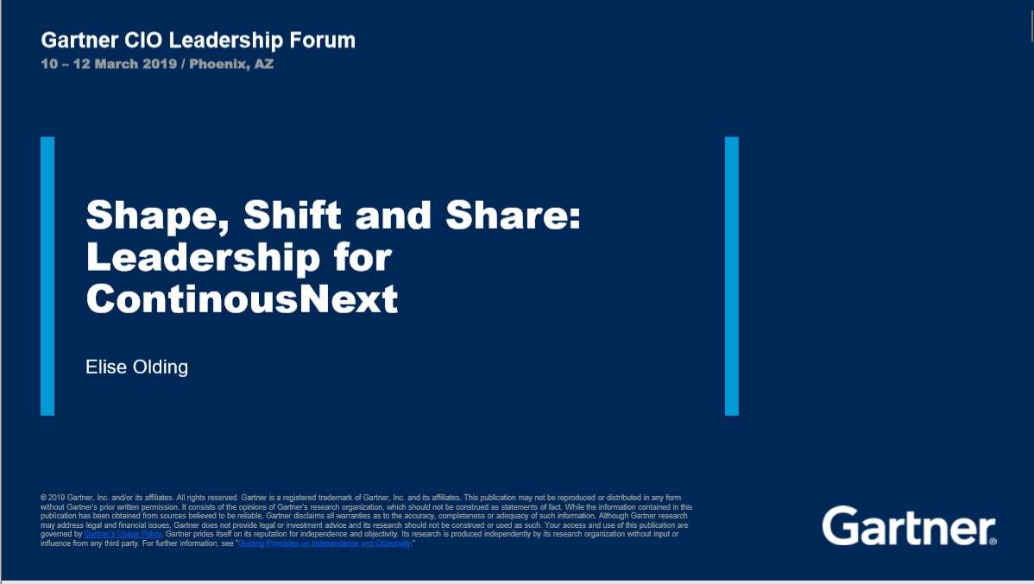

Slide 3
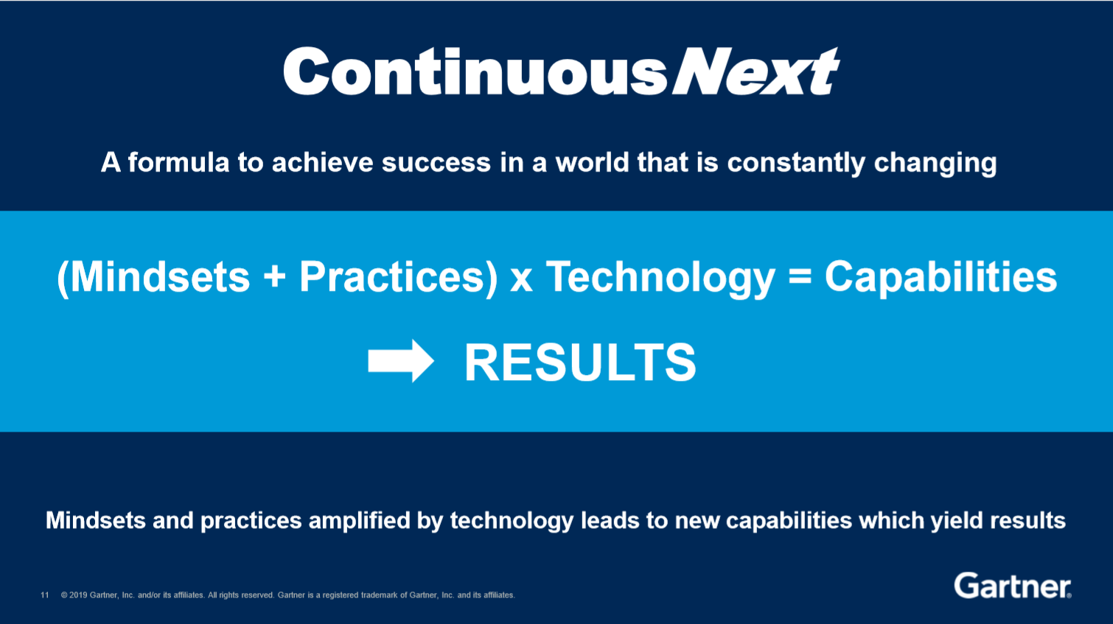
ContinuousNext
the posture everyone should adopt in order to face and adapt to changes in technology, competition, and business

Slide 4
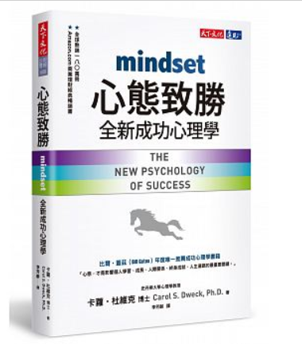
MindSet
大綱介紹

Slide 5
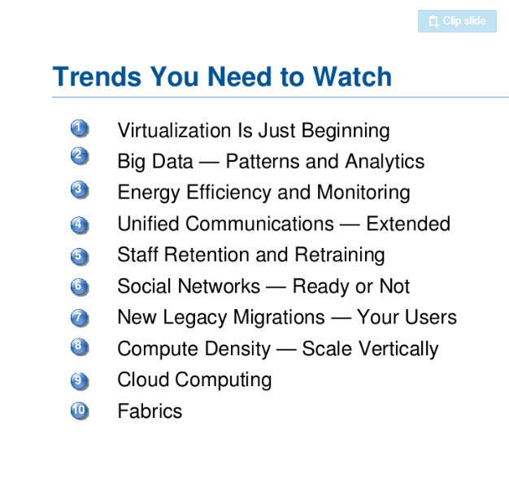
Technology
Top 10 Trends To Watch in IT Infra and Operations by Gartner

Slide 6
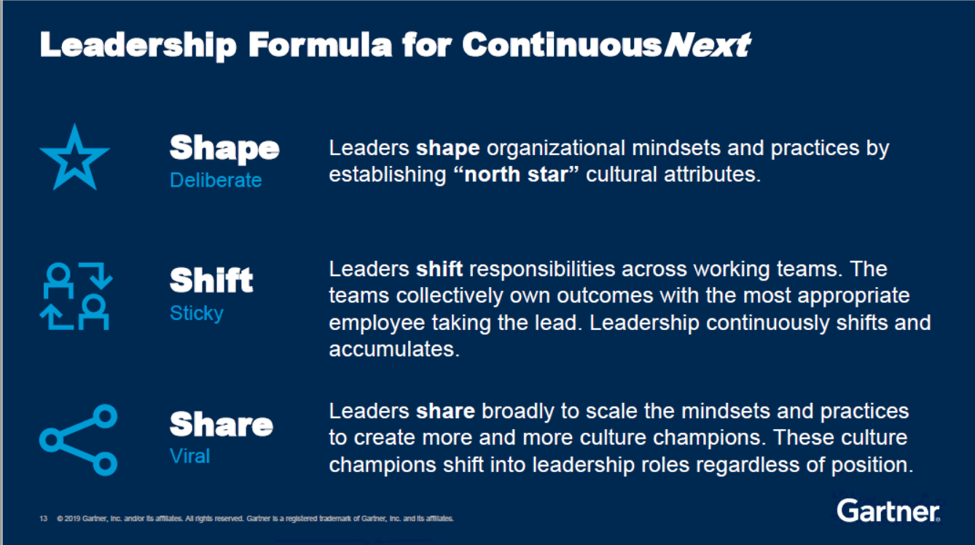
Leadership Formula for Continuous Next

Slide 7
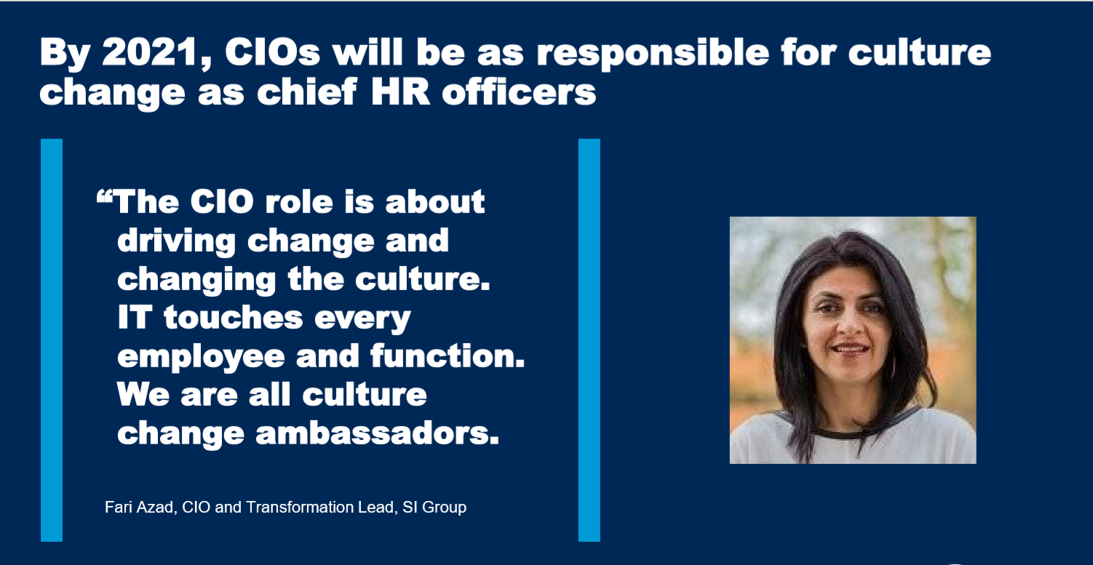
Shape

Slide 8
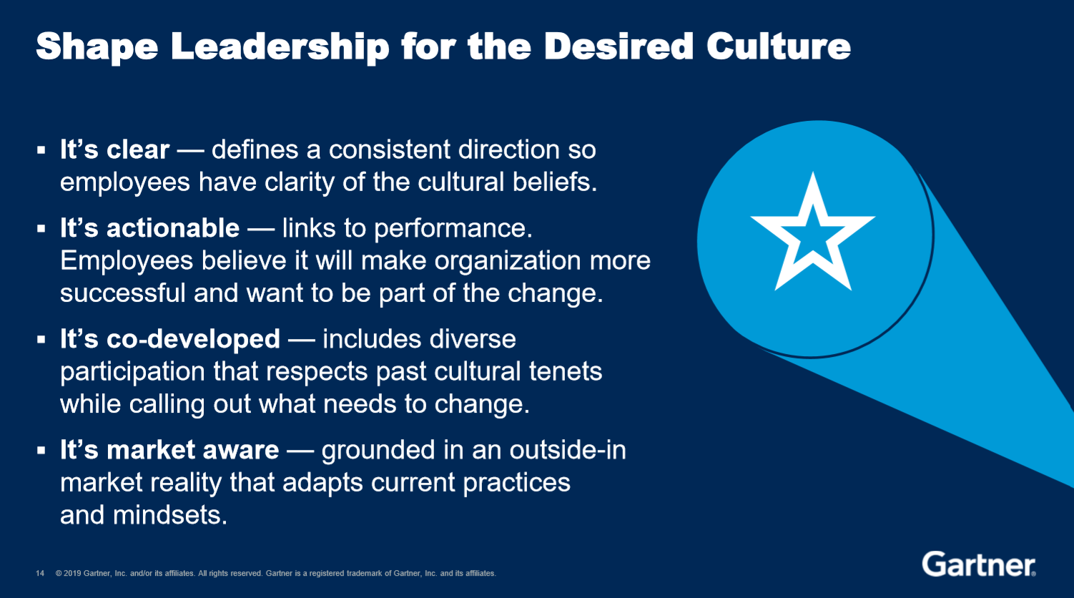
Shape

Slide 9
正在看
Palmer, I. & Hardy,C.(2000), Thinking About Management: Implications of Organizational Debates for Practice, London: Sage Publications. Rainey, H. G.(1997),Understanding and Managing Public Organizations, 2nd., eds., C.A.: Jossey- Bass Publishers. Schein, E. H.(1992), Organizational Culture and Leadership, 2nd ., eds., C.A.: Jossey- Bass Publishers. Vinzart, J. C. & Vinzart, D. H.(1996), Strategic Management and Total Quality Management: Challenges and Choices”, Public Administration Quarterly, Vol.20., No.2., pp.201- 219.

Slide 10
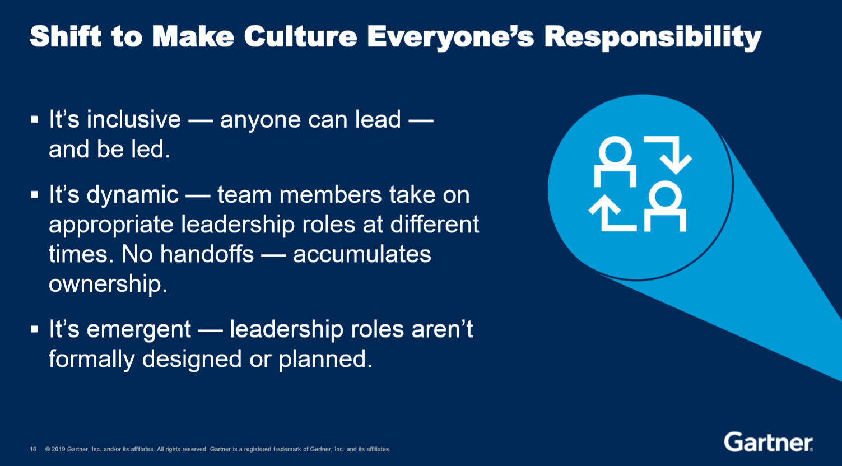
Shift

Slide 11

Shift
As Covey defines it, “delegating involves clear, up-front mutual understanding and commitment in five areas.” Here are the five:
Desired results:
Guidelines:
Resources:
Accountability:
Consequences:

Slide 12
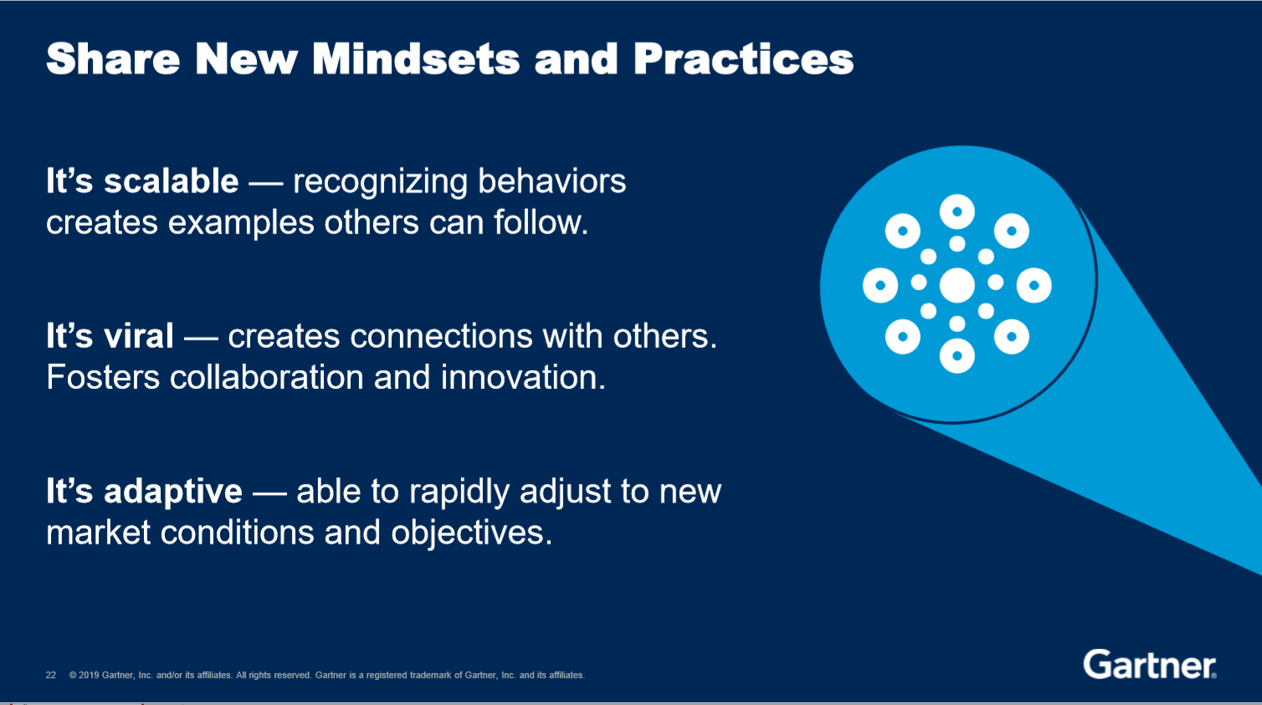
Share

Slide 13
Share
找資料中

